Slide 1
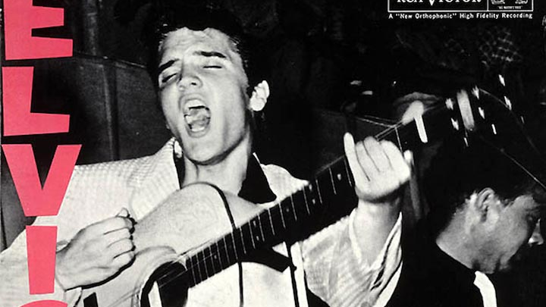
Music Project for 1945-1960
Sarah Lewis
AICE US History
August 29th, 2022

Slide 2
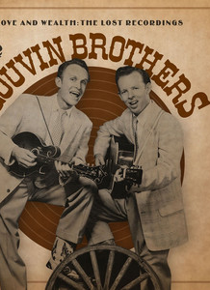
County Folk- There’s a Higher Power
Year: Released in 1959
Artist/ Band: Written by the Louvin Brothers; this was a duo of 2 brothers named Charlie and Ira Louvin
Synopsis: the song is about the different parts of Christianity, giving examples of time in life where either the lord will help one or the consequences of one’s sins
Cultural Ties/ Analysis: This reflects the time period because, during the 1950’s, church membership grew 63.3% between 1950-1960. The song states, “when burden seem to overcome” referring to one’s sins. In addition to this, it also states, “So sing and shout walk and talk” this is referring to praying to Jesus in time of need. There is a repetitive sang of “there’s a higher power” when introducing a problem and how the lord and prayer may fix it. In all this song is relevant to the time period due to the increased number of people turning to god and to help them.
Fun Fact: the album this song comes from is called “Satan is Real”

Slide 3
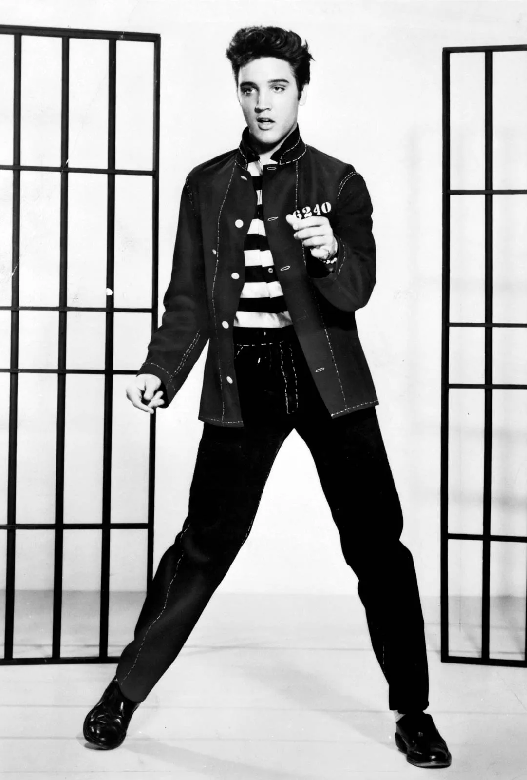
Rock & Roll- Jailhouse Rock
Year Produced: 1957
Artist: Elvis Presley
Synopsis: the song Jailhouse Rock is about a band playing in a jailhouse, the song goes through the different people who were playing instruments in the band.
Fun Fact: the song was extremely popular making #1 in US and UK music charts, for multiple weeks as well.

Slide 4
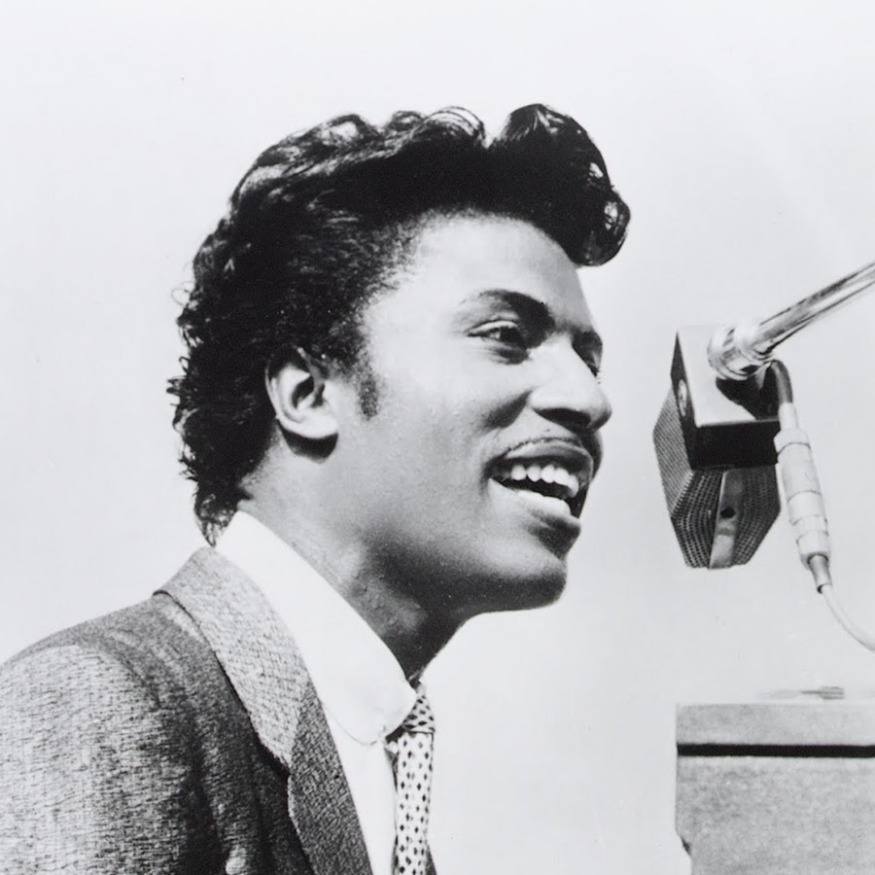
Rock & Roll #2- Good Golly Miss Molly
Year Produced: 1958
Artist: Little Richard
Synopsis: the song is about a girl named Molly who enjoys rock & roll music, and enjoys dancing to it by the line “when you caught Miss Molly rockin”. The artist also admits he would like to impress her with the line “Gonna buy a diamond ring”
Fun Fact: Little Richard who produced this song was given the nickname, “Founding father of rock”

Slide 5
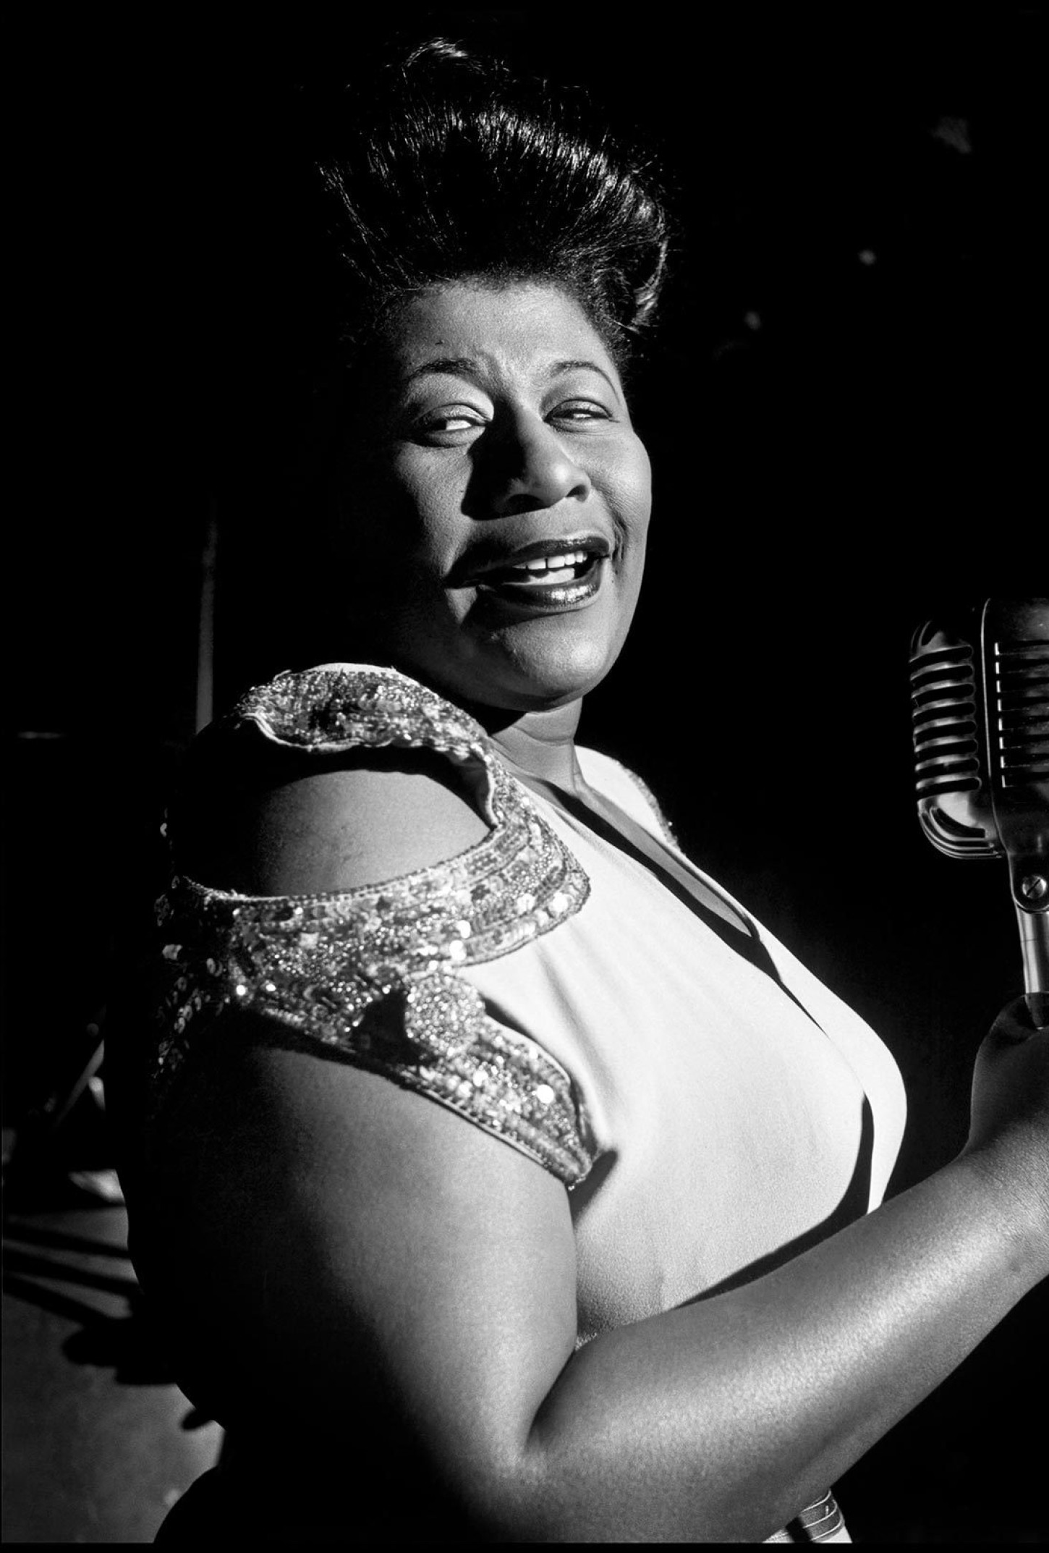
Jazz- Dream a Little Dream of Me
Year Produced: 1950
Artist: Ella Fitzgerald & Louis Armstrong
Synopsis: this song is about lovers saying goodnight to one another, one wishes that their significant other will dream about them at night
Fun Fact: Ella Fitzgerald was known as the “Queen of Jazz”, the song was originally written in 1931 by Doris Day, but remastered by Ella Fitzgerald & Louis Armstrong

Slide 6
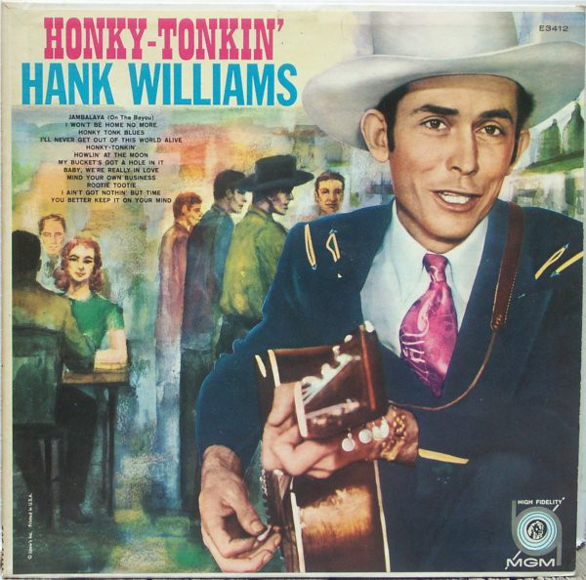
Country Western- Honky Tonkin
Year produced: 1948
Artists: Hank Williams With his Drifting Cowboys
Synopsis: the song Honky Tonkin is about a man taking his lady out on the town to go “Honky Tonkin”. In modern day, the definition of a “Honky Tonk” is a bar that provides country music entertainment for the guest of the establishment. Meaning, that he is referring to taking his lady out to a Honky Tonk bar(s)
Fun Fact: when the song came out in 1948 it made #14 on the US country music charts

Slide 7
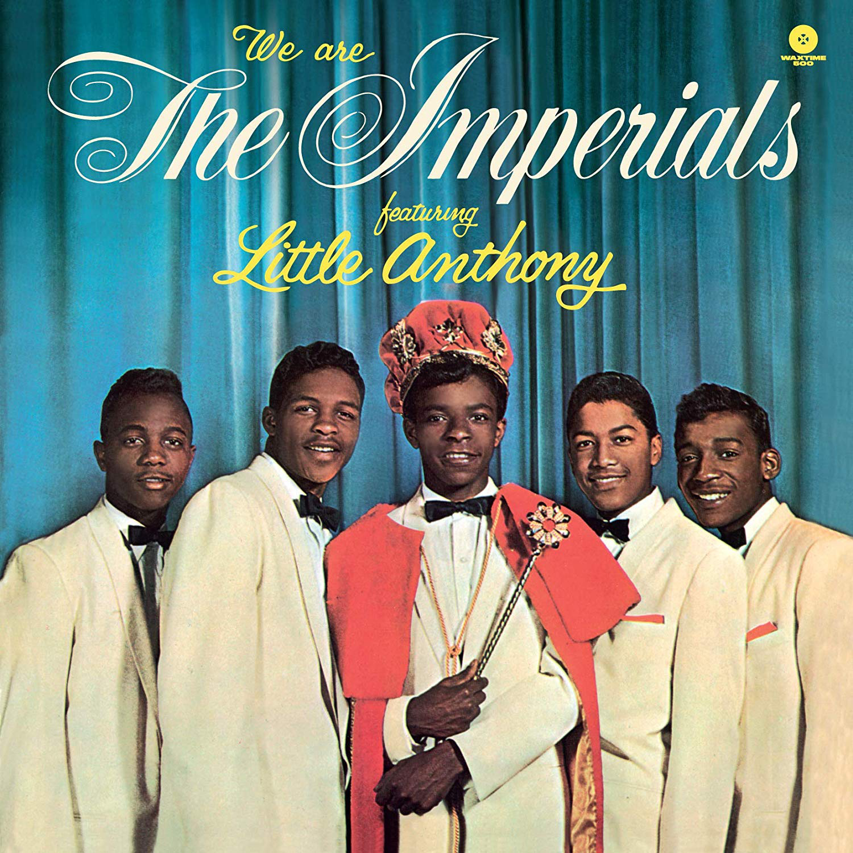
R & B- Tears on my Pillow
Year Produced: 1959
Artist: Little Anthony and the Imperials
Synopsis: the song is about a man being heart broken over someone, he states lines like “you broke my heart” and “I’d gladly take you back”, in the song you can hear the pain this person is feeling over the person he lost.
Fun Fact: “Little Anthony” a.k.a Anthony Gourdine had a book written about his life called “Little Anthony: My Journey, My Destiny” was published in 2014 by Arlene Krieger

Slide 8
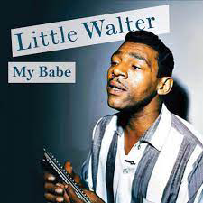
R & B #2- My Babe
Year Produced: 1951
Artist: Little Walter
Synopsis: the song My Babe is about the artist girlfriend who is loyal to him and extremely loving, you can see this by the line “my baby don’t stand no cheatin” and “my babe, I know she loves me” he repeats these 2 lines for most of the song emphasizing how wonderful she is.
Fun Fact: My Babe was #1 on the R & B charts in 1955

Slide 9
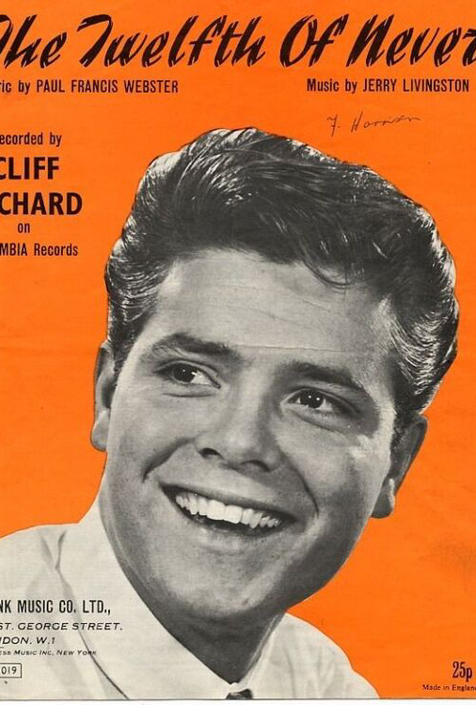
Ballads- The Twelfth of Never
Year Produced: 1957
Artist: Johnny Mathis
Synopsis: the song The Twelfth of Never is about how much a man loves his girlfriend. He uses lines like, “I need you, oh my darling” to show his true love for her.
Fun Fact: In the United States it was #9 on the billboard music charts, and #2 on the charts in Australia

Slide 10
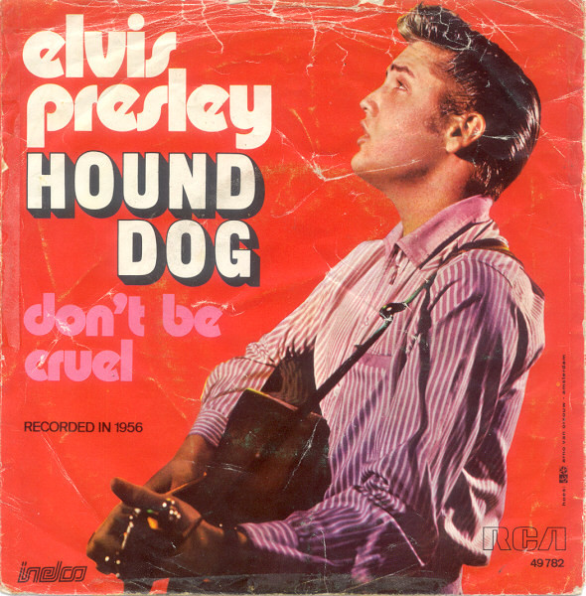
Funk- Hound Dogs
Year Produced: 1956
Artist: Elvis Presley
Synopsis: the song Hound Dog is someone who would be described as a “hound dog”, however this is meant in a negative conotation as this person is “crying all the time” and “you said you was high-classed, well, that’s just a lie”.
Fun Fact: 3 million copies were sold of Elvis Presley’s Hound dog in one year (1958)

Slide 11
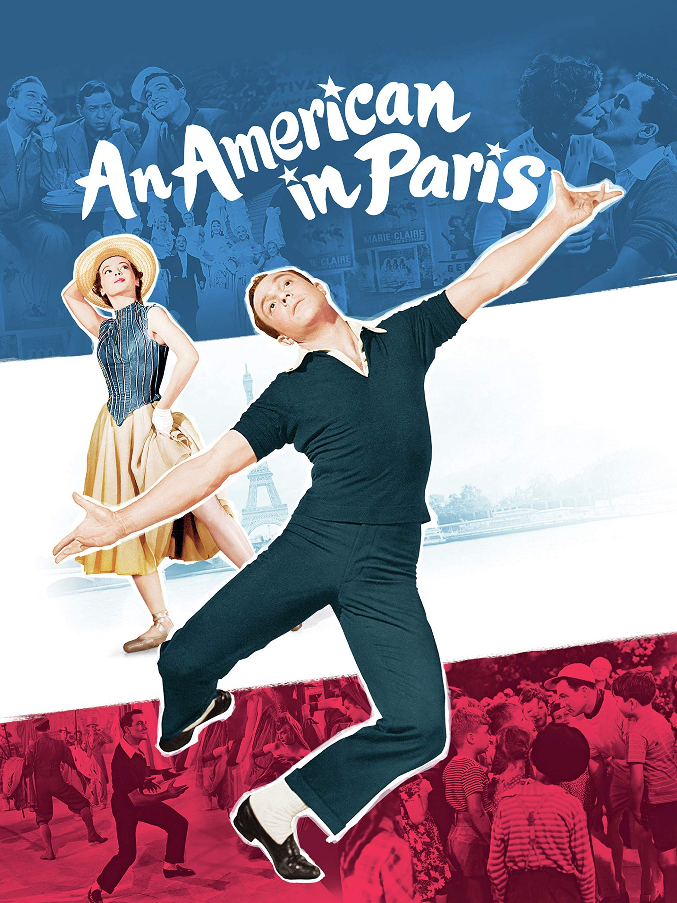
Musical/Theatrical- Love is Here to Stay
Year Produced: 1951
Artist: Gene Kelly
Synopsis: the song is about how a man thinks the connection he has with a women will last for a long time. He is certain of it when he states, “it’s very clear”. He gives examples of things that will happen before he runs out of love for her.
Fun Fact: this song is from the movie An American in Paris, which is set up as a musical

